Slide 1
Linguistic Data Analysis
Stat 133 Final Project
Mengxian Qian, Sung Jik Cha

Slide 2
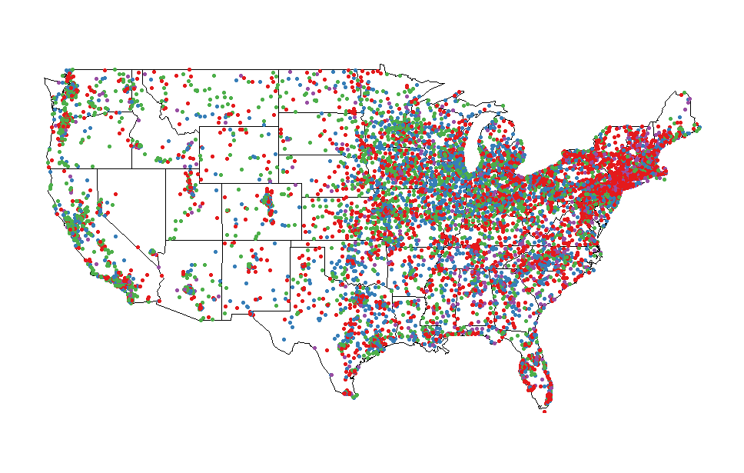
Analysis on Removed Observations
Most Frequently Omitted Questions :
Q092, Q083, Q071, Q095

Slide 3
Analysis on Removed Observations
Removed observations uniformly distributed by state? No.
- Chi-square test for goodness-of-fit
- p-value < 0.01, reject null-hypothesis

Slide 4
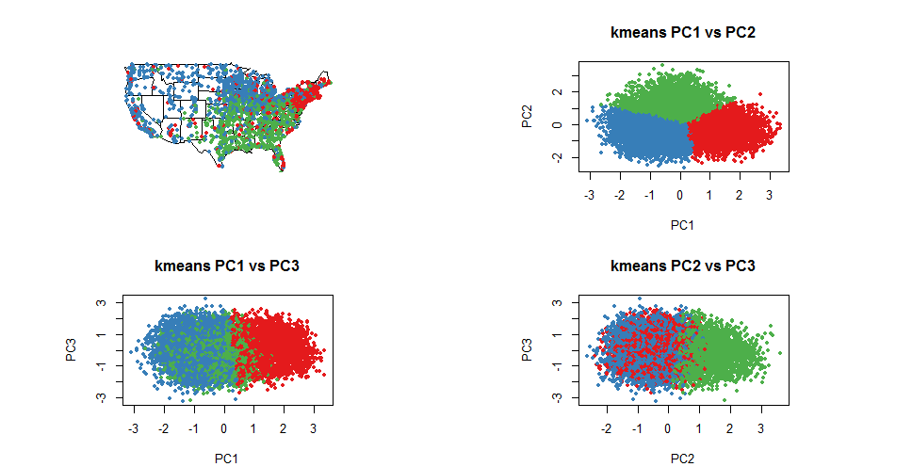
Analysis on K-means Clustering
1.a K means Clustering with 10000 random samples, 3 clusters, 3 PCs
clusters divide along questions that give more weight in PC1 and PC2, i.e. "Q056.2" "Q073.1" "Q080.1" "Q105.1" for PC1 and "Q050.9" "Q071.5" "Q076.4" "Q103.4" for PC2.

Slide 5
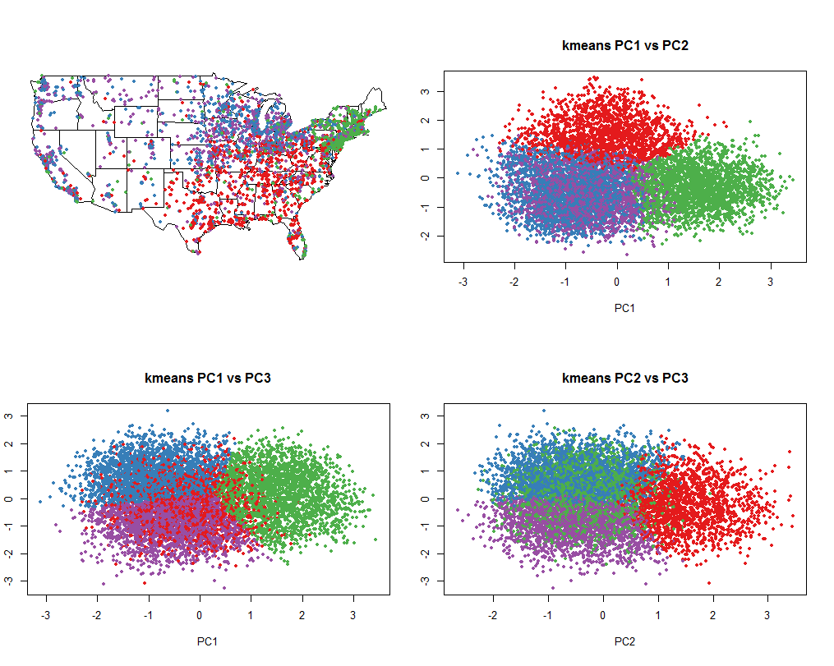
Analysis on K-means Clustering
1.b K means Clustering with 10000 random samples, 6 clusters, 3 PCs

Slide 6
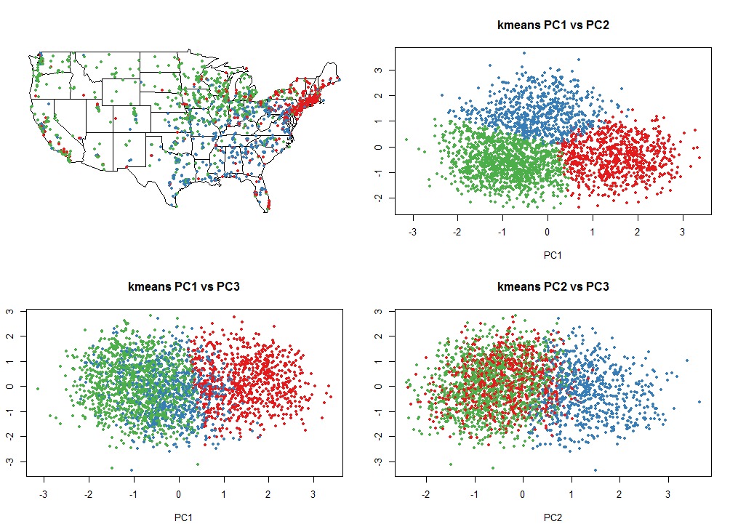
Analysis on K-means Clustering
1.c K means Clustering with 3000 random samples, 3 clusters, 3 PCs

Slide 7
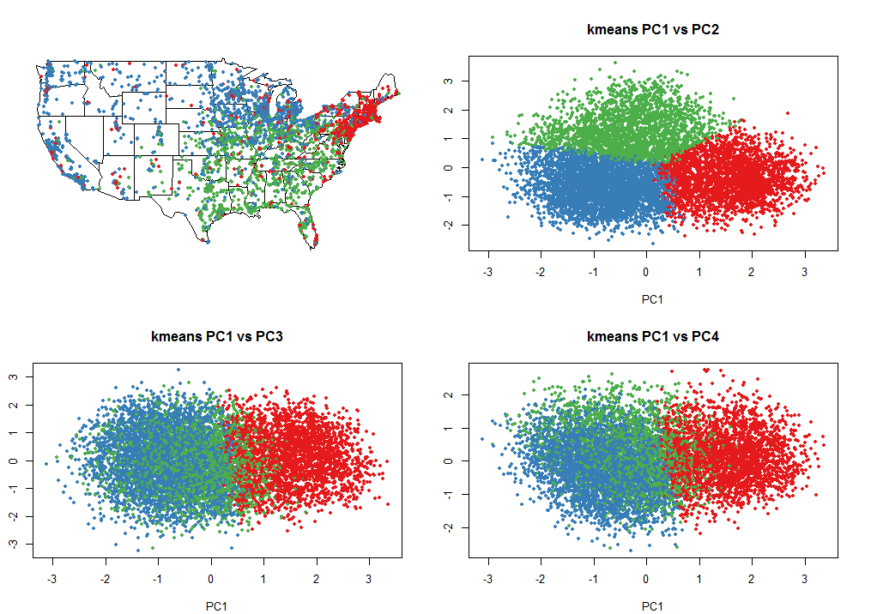
Analysis on K-means Clustering
1.d K means Clustering with 10000 random samples, 3 clusters, 4 PCs

Slide 8
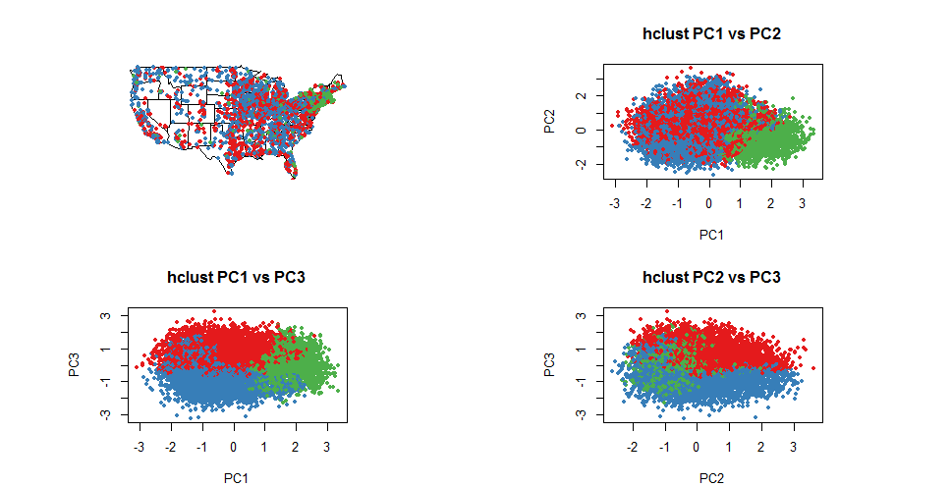
Analysis on Heirarchical Clustering
2.a Hierarchical Clustering with 10000 random samples, 3 clusters, 3 PCs

Slide 9
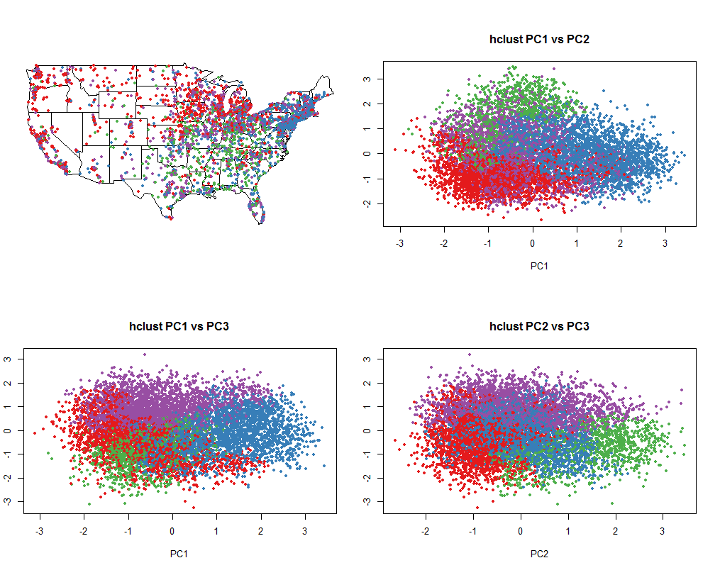
Analysis on Heirarchical Clustering
2.b Hierarchical Clustering with 10000 random samples, 4 clusters, 3 PCs

Slide 10
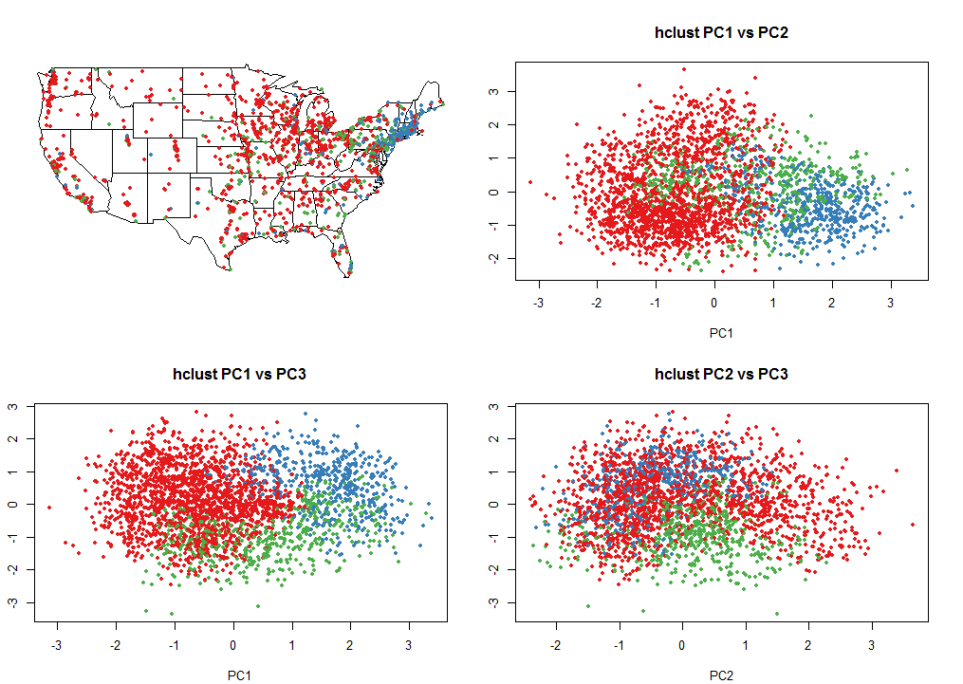
Analysis on Heirarchical Clustering
2.c Heirarchical Clustering with 3000 random samples, 3 clusters, 3 PCs

Slide 11
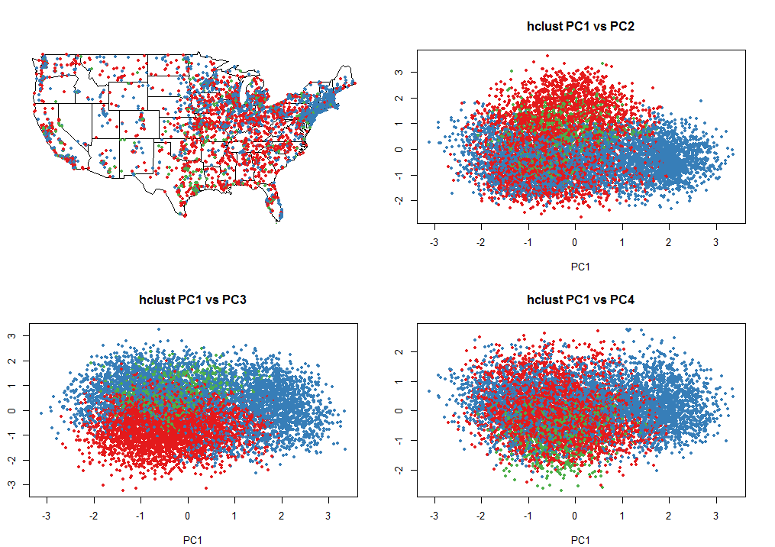
Analysis on Heirarchical Clustering
2.d Hierarchical Clustering with 10000 random samples, 3 clusters, 4 PCs

Slide 12
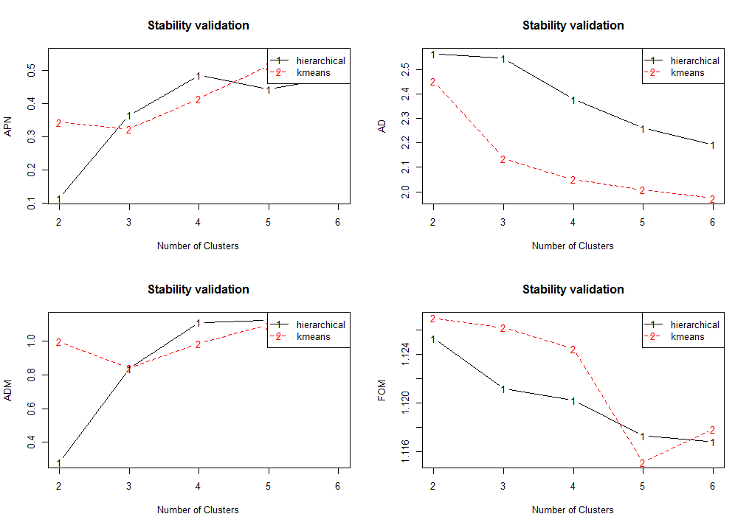
Analysis on Clustering Stability
3.a Clustering Stability with 10000 random samples, 3 PCs, clusters from 2 to 6
Score Method Clusters
APN 0.0038 hierarchical 2
AD 1.9755 kmeans 6
ADM 0.0488 hierarchical 2
FOM 1.1128 hierarchical 6

Slide 13
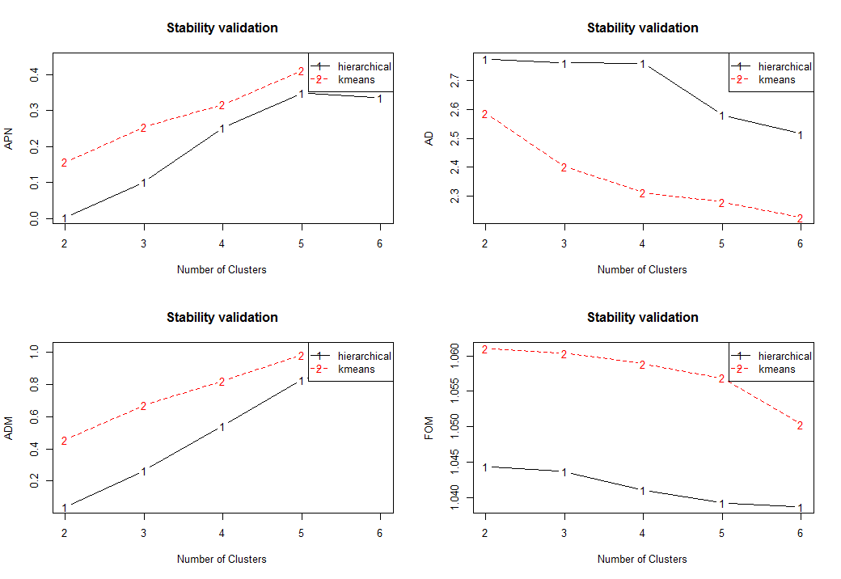
Analysis on Clustering Stability
3.b Clustering Stability with 10000 random samples, 4 PCs, clusters from 2 to 6
Score Method Clusters
APN 0.0037 hierarchical 2
AD 2.2258 kmeans 6
ADM 0.0401 hierarchical 2
FOM 1.0386 hierarchical 6

Slide 14
PCA Analysis
PC1 PC2 PC3
Q073.6 Q065.2 Q097.5
Q080.8 Q076.1 Q098.1
Q105.2 Q103.3 Q107.3
Q106.1 Q118.7 Q120.1

Slide 15
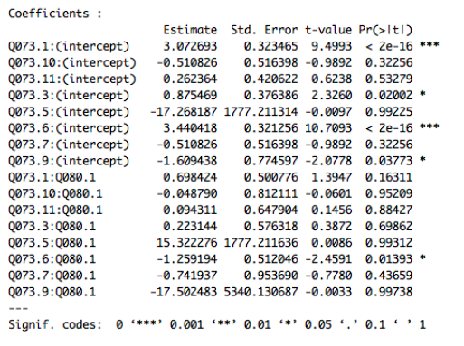
Multinomial logit model
Q73~Q80.1
Q80.1 -> Less likely Q73.6 (base case Q73.2)
Call the situation when rain falls while the sun is shining
as‘sunshower’ -> Less likely she/she call the rubbersoled
shoes worn in gym class as ‘tennis’!

Slide 16
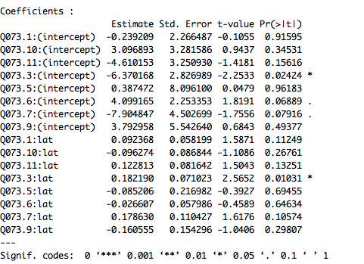
Multinomial logit model
Q73~ Latitude
The higher the latitude->
more likely choose 73.3
The higher the latitude->
more likely call rubber-soled
shoes ‘gymshoes’!

Slide 17
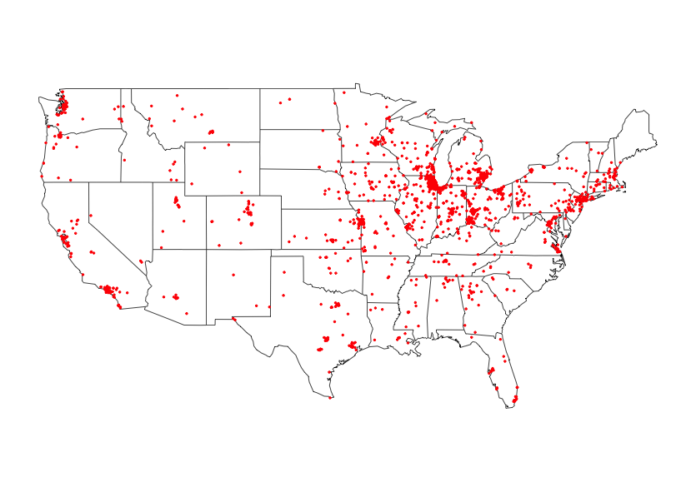
Regional distribution
Q73.3

Slide 18
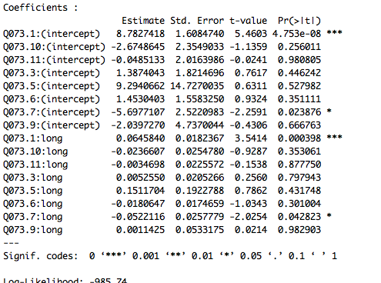
Multinomial logit model
In the higher longitude -> more people choose
Q73.1, less people choose Q73.7
In the higher longitude -> more people would call
ruber-soled shoes worn in gay class as ‘sneaker’,
less people would call it ‘running shoes’!

Slide 19
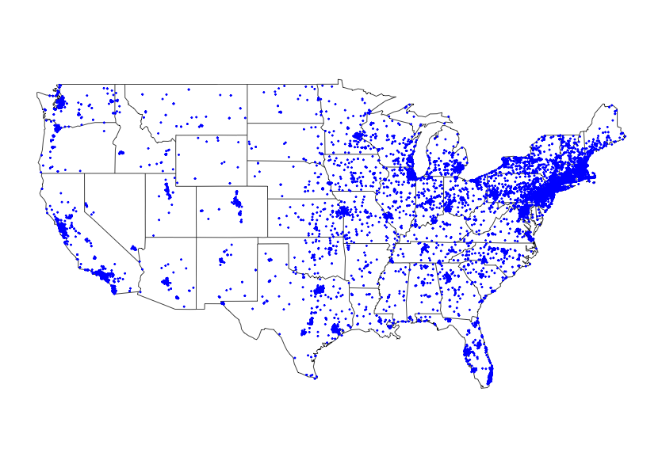
Regional distribution
Q73.1

Slide 20
Stat 133 Final Project
Thank you!

